Slide 1
Increasing Sales of Organic Products: Insights and Recommendations
Aaron King

Slide 2
Table Of Contents
Business Problem
Identifying Organic Buyers and Increasing Profitability
Exploratory Data Analysis (EDA)
Insights from Customer Data Exploration
Modeling Approach
Building Predictive Models
Key Findings
Understanding Organic Buyers
Profiling Example Buyers
Recommendations
Strategies to Increase Organic Sales
Technical Appendix

Slide 3

Identifying Organic Buyers and Increasing Profitability
Context:
Management seeks to understand organic buyers and the potential profitability of organic products.
Key objectives: Identify likely buyers and recommend strategies to increase organic product sales.
Notes:
Callout: An analysis of loyalty program data is needed to profile organic buyers, so that we can help the company sell more organic products to those buyers.

Slide 4
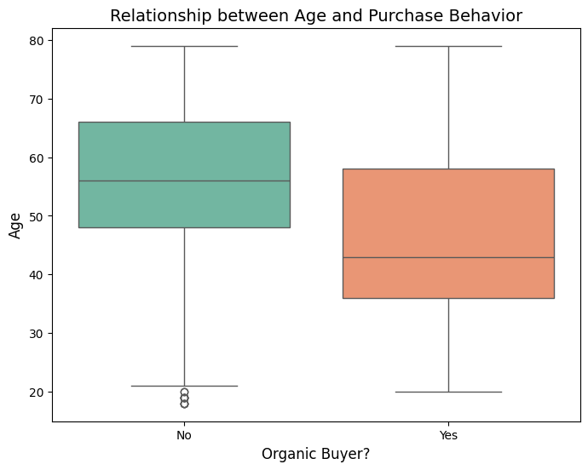
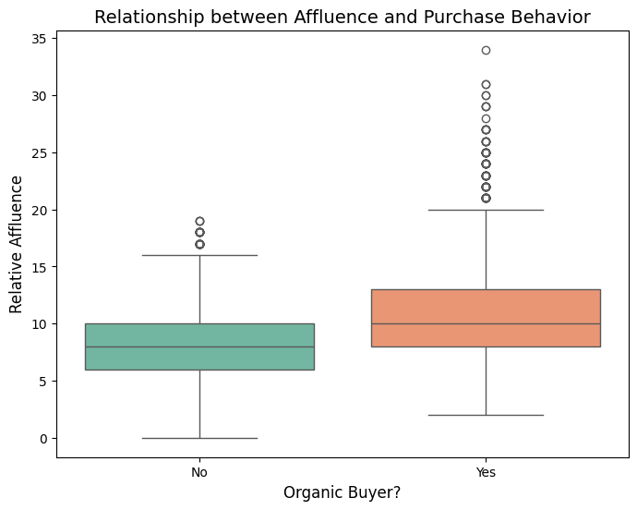
Insights from Customer Data Exploration
Notes:
Callout: A majority of organic customers tend to be younger and/or more affluent, as we can gather from the box plots.

Slide 5
Insights from Customer Data Exploration (cont.)
Key Observations:
Younger customers (mid-40s and under) seem to dominate organic purchases.
Higher affluence correlates with greater chance to buy organic products.
Gender impact observed: Unknown genders are less likely to buy organic products.
Notes:
Callout: To be clear to our audience, we also state that missing data was handled and irrelevant variables excluded, such as Customer ID.

Slide 6

Building Predictive Models
Summary:
Four models created: Decision Tree #1 and #2, Random Forest, and Gradient Boosting.
Criteria: Accuracy, Precision, Recall, and AUC.
Notes:
Callout: The final model, the gradient boosting model, was selected based on balanced performance with the considered criteria and business relevance. While no model was significantly worse than any other model, the gradient boosting model had most of the highest marks for our criteria based on the testing data.

Slide 7
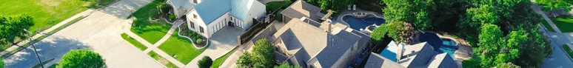
Understanding Organic Buyers
Model Insights:
High affluence (> 10.5) and younger age (< 40) are primary predictors of organic buyers.
Unknown gender customers are less likely to buy organic products.
Regions with affluent urban neighborhoods offer the highest potential for sales expansion.
Notes:
Callout: I created a profile developed to guide marketing efforts.

Slide 8


Profiling Example Buyers
Example Buyer: Taylor
A young and well-to-do customer in his/her thirties – the more affluent, the more likely they are to buy. He/she lives in an upscale urban neighborhood or recently moved to suburbia, perhaps with young kids.

Slide 9
Strategies to Increase Organic Sales
Actions:
Focus marketing on younger, affluent customers.
Expand organic product availability in urban affluent regions.
Engage customers with personalized promotions (e.g., coupons).
Investigate and address barriers for customers with "Unknown" gender.
Notes:
Callout: Essentially, we went them to find ways to engage this targeted customer base so that they can optimize their resources. Perhaps coupons can work as a tactic as well.

Slide 10
Technical Appendix: Initial Changes
Data Preparation:
Addressed missing values using dropna function on rows containing missing values, leaving us with 16,408 observations.
Created dummy variables as necessary.
Variables excluded:
TargetAmt (perfectly collinear with our Y variable)
ID (unique identifier variable, irrelevant for analysis)
Created test and train data sets with default split.

Slide 11
Technical Appendix: Model Details
Model Specifications:
Decision Tree #1
max depth: 25, min samples: 80, ccp: 0.001
Decision Tree #2
max depth: 20, min samples: 10, ccp: 0.001
Random Forest
n estimators: 150, max features: 7, max depth: 50, min samples: 30
Gradient Boosting
n estimators: 100, learning rate: 0.1, max depth: 3

Slide 12
Technical Appendix: Model Evaluation
Model | Training Data |  |  |  | Test Data
 | Accuracy | Precision | Recall | ROC | Accuracy | Precision | Recall | ROC
Decision Tree #1 | 0.7985 | 0.6481 | 0.4083 | 0.7809 | 0.7996 | 0.6531 | 0.4080 | 0.7817
Decision Tree #2 | 0.8109 | 0.6864 | 0.4132 | 0.8004 | 0.8111 | 0.6899 | 0.4085 | 0.7975
Random Forest | 0.8233 | 0.7683 | 0.3946 | 0.8525 | 0.8157 | 0.7467 | 0.3688 | 0.8165
Gradient Boosting | 0.8205 | 0.7147 | 0.4396 | 0.8341 | 0.8183 | 0.7152 | 0.4230 | 0.8196
Because the Gradient Boosting method did the best on 3 of 4 test data metrics (and second best on the other metric), I chose that model.

Slide 13
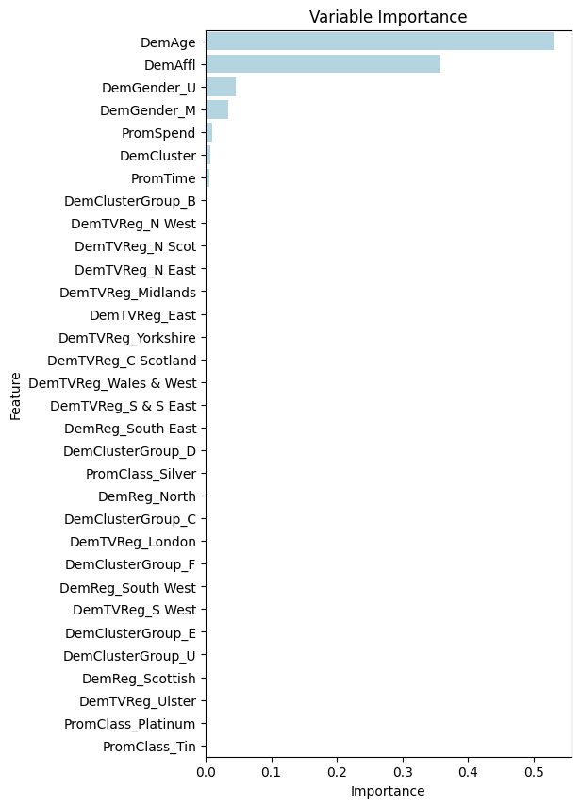
Technical Appendix: Variable Importance
Summary:
Our final model shows that the most important variables really came down to two factors – age (DemAge) and affluence (DemAffl).
The other notable variable is gender, identified by DemGender_U and DemGender_M
Of the remaining variables, Loyalty members’ spending (PromSpend) seemed to have the largest influence.

